Slide 1
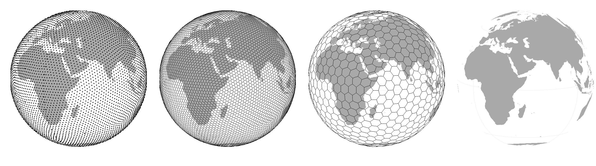
Species ranges II – applied issues, dynamics (+ intro to metapopulations)
Petr Keil
Notes:
Hi, my name is Petr Keil and this is my project Biodiversity dynamics across a continuum of space, time, and their scales.

Slide 2
Geographic range vs conservation status
How small ranges make species vulnerable
Notes:
I am qualified to deliver all this

Slide 3
xxx
refs
Notes:
And this is what I will address
The grand objective is to figure out…
Specifically, BEAST will ………………………
I will do this in 5 work packages.

Slide 4
You should know
xxx
Notes:
OK, so here we are moving to the outer space
Spaceborne satellite sensors such as MODIS or Landsat can classify landscape to spectral species, and can measure spectral diversity
Unlike taxonomic data, spectral data suffer no sampling bias and are available over any scale
In WP4 I will seek parallels between dynamics of taxonomic and spectral diversity

Slide 5
Range collapses
How species go extinct?
Notes:
I am qualified to deliver all this

Slide 6
xxx
refs
Notes:
And this is what I will address
The grand objective is to figure out…
Specifically, BEAST will ………………………
I will do this in 5 work packages.

Slide 7
You should know
xxx
Notes:
OK, so here we are moving to the outer space
Spaceborne satellite sensors such as MODIS or Landsat can classify landscape to spectral species, and can measure spectral diversity
Unlike taxonomic data, spectral data suffer no sampling bias and are available over any scale
In WP4 I will seek parallels between dynamics of taxonomic and spectral diversity

Slide 8
Range expansions
Intro to invasion biology on few slides
Notes:
I am qualified to deliver all this

Slide 9
xxx
refs
Notes:
And this is what I will address
The grand objective is to figure out…
Specifically, BEAST will ………………………
I will do this in 5 work packages.

Slide 10
You should know
xxx
Notes:
OK, so here we are moving to the outer space
Spaceborne satellite sensors such as MODIS or Landsat can classify landscape to spectral species, and can measure spectral diversity
Unlike taxonomic data, spectral data suffer no sampling bias and are available over any scale
In WP4 I will seek parallels between dynamics of taxonomic and spectral diversity

Slide 11
Zooming in – spatial structure of populations
An intro to metapopulation ecology
Notes:
I am qualified to deliver all this

Slide 12
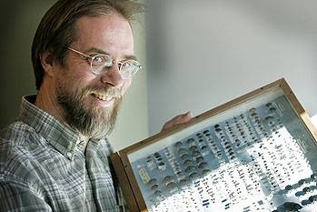
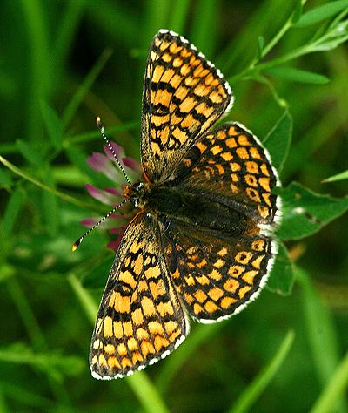
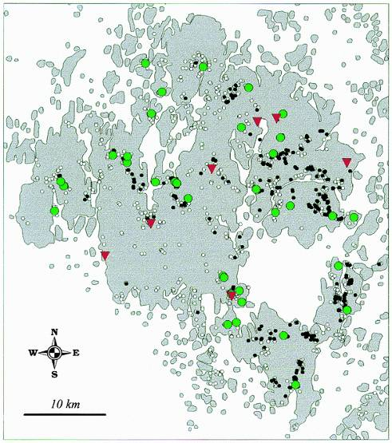
“The world is patchy”
Ilkka Hanski
Melitaea cinxia
(hnědásek kostkovaný)
Åland archipelago (Finland)
4000 patches
400 of them occupied
Hanski (1999) Metapopulation Ecology
Hanski (2011) PNAS
Notes:
And this is what I will address
The grand objective is to figure out…
Specifically, BEAST will ………………………
I will do this in 5 work packages.

Slide 13
Metapopulace = populace populací
Notes:
And this is what I will address
The grand objective is to figure out…
Specifically, BEAST will ………………………
I will do this in 5 work packages.

Slide 14
Metapopulace = populace populací
Notes:
And this is what I will address
The grand objective is to figure out…
Specifically, BEAST will ………………………
I will do this in 5 work packages.

Slide 15
Metapopulace = populace populací
Notes:
And this is what I will address
The grand objective is to figure out…
Specifically, BEAST will ………………………
I will do this in 5 work packages.

Slide 16
Metapopulace = populace populací
Notes:
And this is what I will address
The grand objective is to figure out…
Specifically, BEAST will ………………………
I will do this in 5 work packages.

Slide 17
Metapopulace = populace populací
A metapopulation is a population of populations distributed in discrete habitat patches that are linked by occasional dispersal.
Rather than track individual organisms through time, a metapopulation approach tracks the occupancy of habitat patches through time.
Metapopulation models can be used to examine factors that cause patch colonizations or patch extinctions.
Hanski (1999) Metapopulation Ecology
Van Nouhuys (2016) Metapopulation Ecology
Notes:
And this is what I will address
The grand objective is to figure out…
Specifically, BEAST will ………………………
I will do this in 5 work packages.

Slide 18
How common are metapopulations?
Probably uncommon, but metapopulation processes likely have significant role in many species
Van Nouhuys (2016) Metapopulation Ecology
Notes:
And this is what I will address
The grand objective is to figure out…
Specifically, BEAST will ………………………
I will do this in 5 work packages.

Slide 19
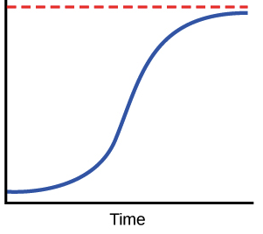


Levins’ model
N… proportion of occupied sites
c… colonization probability
e… extinction probability
t… time
K… carrying capacity
K
N
$$\frac{dN}{dt}=cN\left(1−N\right)−eN$$
$$K=1−\frac{e}{c}$$
At equilibrium, therefore, some fraction of the patches can constantly be unoccupied.
Van Nouhuys (2016) Metapopulation Ecology
Levins (1969) Bull. Entomol. Soc. Amer.
Notes:
And this is what I will address
The grand objective is to figure out…
Specifically, BEAST will ………………………
I will do this in 5 work packages.

Slide 20
Extensions of Levins’ model include:
Rescue effect – extinction rates are low in systems with high N (Hanski 1985)
Larger populations are less likely to go extinct (Hastings & Wolin 1989)
Larger empty patches are more likely to be colonized (Hastings & Wolin 1989)
Species interactions (Nee & May 1992)
Colonization is determined by connectivity (connected patches are more likely to be colonized; Hanski 1994)
Source & sink populations
Van Nouhuys (2016) Metapopulation Ecology
Notes:
OK, so here we are moving to the outer space
Spaceborne satellite sensors such as MODIS or Landsat can classify landscape to spectral species, and can measure spectral diversity
Unlike taxonomic data, spectral data suffer no sampling bias and are available over any scale
In WP4 I will seek parallels between dynamics of taxonomic and spectral diversity

Slide 21
Thank you. Questions?

